Slide 1
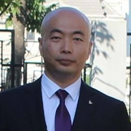
06. 资源塑形, HATEOAS, Media Type
杨旭, 331335713@qq.com
公众号: 草根专栏
Notes:
Be specific and direct in the title. Use the subtitle to give the specific context of the speech.
-The goal should be to capture the audience’s attention which can be done with a quote, a startling statistic, or fact. It is not necessary to include this attention getter on the slide.

Slide 2
今天的内容
GET 返回资源的塑形
HATEOAS: Hypermedia as the Engine of Application State
自定义Media Type
Notes:
The counterargument should be the most common argument against the topic. The goal for this slide is to address the counterargument in such a way as to actually strengthen the original topic. Be sure to address each piece of evidence against the topic. As you address each piece of evidence elaborate on the text found on the slide. Remember to transition to the final slide, the action step.

Slide 3
资源塑形
Notes:
Dedicate this entire slide to the thesis statement. It is the reason the speech is being given. Use this time to reveal the three main points of the speech (slides 4,5,6) as an overview for the direction of the speech:
-[type main point #1 here]
-[type main point #2 here]
-[type main point #3 here]
Be sure to transition to the first main point and the next slide.

Slide 4
资源塑形
如果资源的属性较多, 而且API消费者只需要一分部属性, 那么就应该考虑资源塑形
集合资源
单个资源
异常处理
Notes:
Use the background points to post details that are not common knowledge, or that the audience will need to understand the context of the speech.
-Do not read these main points from the PowerPoint, instead elaborate on these points during the speech.

Slide 5
HATEOAS
Notes:
Dedicate this entire slide to the thesis statement. It is the reason the speech is being given. Use this time to reveal the three main points of the speech (slides 4,5,6) as an overview for the direction of the speech:
-[type main point #1 here]
-[type main point #2 here]
-[type main point #3 here]
Be sure to transition to the first main point and the next slide.

Slide 6
HATEOAS Hypermedia as the Engine of Application State
REST里最复杂的约束, 构建成熟REST API的核心
可进化性, 自我描述
超媒体(Hypermedia, 例如超链接)驱动如何消费和使用API
Notes:
Use the background points to post details that are not common knowledge, or that the audience will need to understand the context of the speech.
-Do not read these main points from the PowerPoint, instead elaborate on these points during the speech.

Slide 7
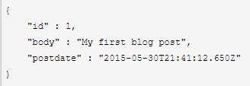
不使用HATEOAS
客户端更多的需要了解API内在逻辑
如果API发生了一点变化(添加了额外的规则, 改变规则)都会破坏API的消费者.
API无法独立于消费它的应用进行进化.
Notes:
Use the background points to post details that are not common knowledge, or that the audience will need to understand the context of the speech.
-Do not read these main points from the PowerPoint, instead elaborate on these points during the speech.

Slide 8
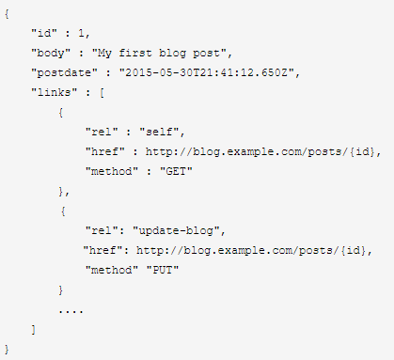
使用HATEOAS
这个response里面包含了若干link, 第一个link包含着获取当前响应的链接, 第二个link则告诉客户端如何去更新该post.
不改变响应主体结果的情况下添加另外一个删除的功能(link), 客户端通过响应里的links就会发现这个删除功能, 但是对其他部分都没有影响.
Notes:
Use the background points to post details that are not common knowledge, or that the audience will need to understand the context of the speech.
-Do not read these main points from the PowerPoint, instead elaborate on these points during the speech.

Slide 9
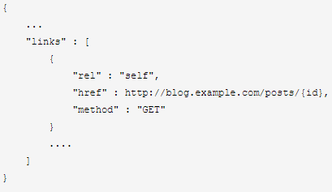
HATEOAS – 展示链接
JSON和XML并没有如何展示link的概念. 但是HTML的anchor元素却知道: <a href="uri" rel="type" type="media type">.
href包含了URI
rel则描述了link如何和资源的关系
type是可选的, 它表示了媒体的类型
我们的例子:
method: 定义了需要使用的方法
rel: 表明了动作的类型
href: 包含了执行这个动作所包含的URI.
Notes:
Use the background points to post details that are not common knowledge, or that the audience will need to understand the context of the speech.
-Do not read these main points from the PowerPoint, instead elaborate on these points during the speech.

Slide 10
如何实现HATEOAS
静态基类
需要基类(包含link)和包装类, 也就是返回的资源里面都含有link, 通过继承于同一个基类来实现
动态类型, 需要使用例如匿名类或ExpandoObject等
对于单个资源可以使用ExpandoObject
对于集合类资源则使用匿名类.
Notes:
Use the background points to post details that are not common knowledge, or that the audience will need to understand the context of the speech.
-Do not read these main points from the PowerPoint, instead elaborate on these points during the speech.

Slide 11
HATEOAS – 动态类型方案
ExpandoObject或匿名类
单个对象
集合
Notes:
Use the background points to post details that are not common knowledge, or that the audience will need to understand the context of the speech.
-Do not read these main points from the PowerPoint, instead elaborate on these points during the speech.

Slide 12
自定义Media Type
Notes:
Dedicate this entire slide to the thesis statement. It is the reason the speech is being given. Use this time to reveal the three main points of the speech (slides 4,5,6) as an overview for the direction of the speech:
-[type main point #1 here]
-[type main point #2 here]
-[type main point #3 here]
Be sure to transition to the first main point and the next slide.

Slide 13
创建供应商特定媒体类型 Vendor-specific media type
上例中使用application/json会破坏了资源的自我描述性这条约束, API消费者无法从content-type的类型来正确的解析响应.
application/vnd.mycompany.hateoas+json
vnd是vendor的缩写，这一条是mime type的原则，表示这个媒体类型是供应商特定的
自定义的标识，也可能还包括额外的值，这里我是用的是公司名，随后是hateoas表示返回的响应里面要包含链接
“+json”
在Startup里注册.
Notes:
Use the background points to post details that are not common knowledge, or that the audience will need to understand the context of the speech.
-Do not read these main points from the PowerPoint, instead elaborate on these points during the speech.

Slide 14
判断Media Type类型
[FromHeader(Name = "Accept")] string mediaType
自定义Action约束.
Notes:
Use the background points to post details that are not common knowledge, or that the audience will need to understand the context of the speech.
-Do not read these main points from the PowerPoint, instead elaborate on these points during the speech.

Slide 15

Day 6

